Slide 1
Transaction Management
SCS2209 - Database II
Ms. Hiruni Kegalle

Slide 2
Serializability
When several concurrent transactions are trying to access the same data item, the instructions within these concurrent transactions must be ordered in some way so as there are no problem in accessing and releasing the shared data item.
Serializable schedule: A schedule S of n transactions is serializable if it is equivalent to some serial schedule of the same n transactions.
Two types
Conflict Serializability
View Serializability

Slide 3
Result Equivalent Schedule
If they produce the same final state of the database
Ex: X=100
Result equivalent is not a good measure but conflict and view equivalent.
S1
Read_item (X); X = X + 10; Write_item (X)
S2
Read_item (X); X = X * 1.1; Write_item (X)

Slide 4
Conflict Equivalent
The schedules S1 and S2 are said to be conflict-equivalent if the following two conditions are satisfied:
Both schedules S1 and S2 involve the same set of transactions (including ordering of actions within each transaction).
Both schedules have same set of conflicting operations. The order of any two conflicting operations is the same in both schedules.

Slide 5
Conflicting Actions
Two operations in a schedule are said to conflict if they satisfy all three of the following conditions:
(1) They belong to different transactions;
(2) They access the same item X; and
(3) At least one of the operations is a write_item(X).
R₁(X);W₂(X);
R₁(X); R₂(X);
R₁(X); W₂(Y);

Slide 6
Example
S1
S2
T1 | T2
R(x)
W(x)
 | R(x)
 | W(x)
R(y)
W(y)
 | R(y)
 | W(y)
T1 | T2
R(x)
W(x)
R(y)
W(y)
 | R(x)
 | W(x)
 | R(y)
 | W(y)

Slide 7
Conflict Serializable
A conflict arises if at least one (or both) of the instructions is a write operation.
The following rules are important in Conflict Serializability:
If two instructions of the two concurrent transactions are both for read operation, then they are not in conflict, and can be allowed to take place in any order.
If one of the instructions wants to perform a read operation and the other instruction wants to perform a write operation, then they are in conflict, hence their ordering is important.
Read;Write
Write;Read

Slide 8
Conflict Serializable
3. If both the transactions are for write operation, then they are in conflict but can be allowed to take place in any order, because the transaction do not read the value updated by each other.
However, the value that persists in the data item after the schedule is over, is the one written by the instruction that performed the last write.
A schedule S is conflict serializable if it is (conflict) equivalent to some serial schedule S’.

Slide 9
Check for Conflict Serializability
Check for the conflicting actions.
Check for a cycle in the Precedence Graph.

Slide 10
Precedence Graph
A simple and efficient method for determining conflict serializability of a schedule is construction of a directed graph called a precedence/conflict/ serializability graph.
A precedence graph is a directed graph G = (N, E) that consists of a set of nodes N= {T1,T2,...,Tn } and a set of directed edges E= {e1, e2,...,em }.
There is one node in the graph for each transaction T _{i} in the schedule.
Each edge e_{i} in the graph is of the form (Tj→Tk ),1 ≤j≤n,1 ≤k ≤ n,where Tj is the starting node of ei and Tk is the ending node of ei.

Slide 11
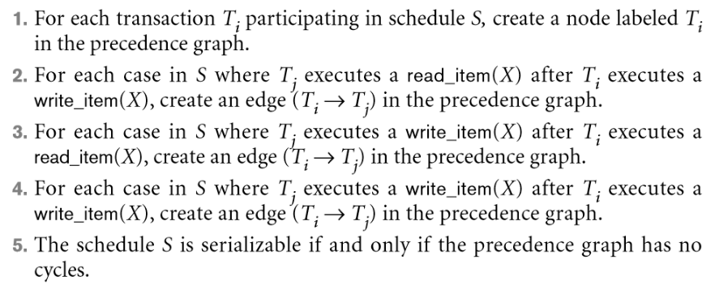
Algorithm

Slide 12
Important
Several serial schedules can be equivalent to S if the precedence graph for S has no cycle.

Slide 13
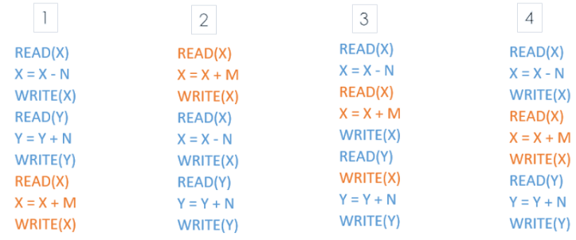
Example 1- Precedence graph
Draw precedence graph for each schedule. Two colors represent 2 transactions; T₁ in Blue and T₂ in orange.

Slide 14
Example 1 - Precedence graph
T1 | T2
r(x)
 | r(x)
w(x)
r(y)
 | w(x)
w(y)

Slide 15
Example 1 - Precedence graph
x
T1 | T2
r(x)
 | r(x)
w(x)
r(y)
 | w(x)
w(y)
T1
T2
x

Slide 16
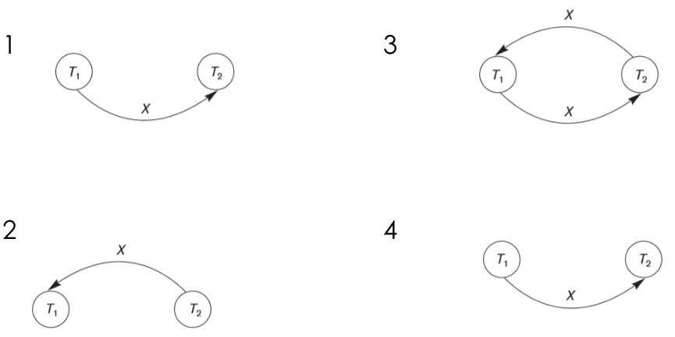
Example 1 - importance of properties

Slide 17
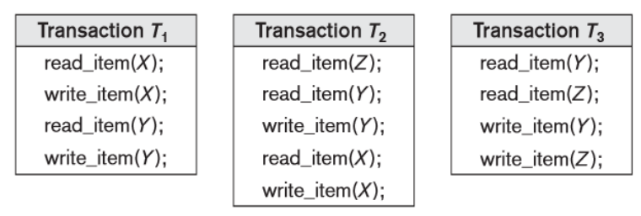
Example 2 - Precedence graph

Slide 18
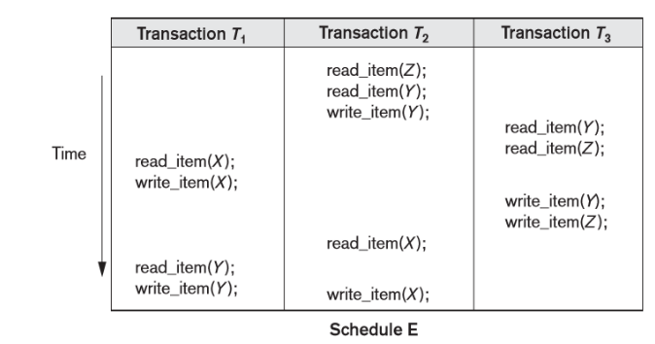
Example 2 - Precedence graph
Draw the serializable graph for the schedule E. Write the equivalent serial schedules if exist.

Slide 19
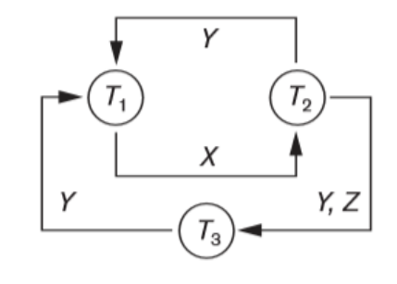
Example 2 - Precedence graph
2 cycles
Cycle X(T1 T2),Y(T2 T1)
Cycle X(T1 T2),YZ (T2 T3),Y(T3 T1)
No Equivalent serial schedules.

Slide 20
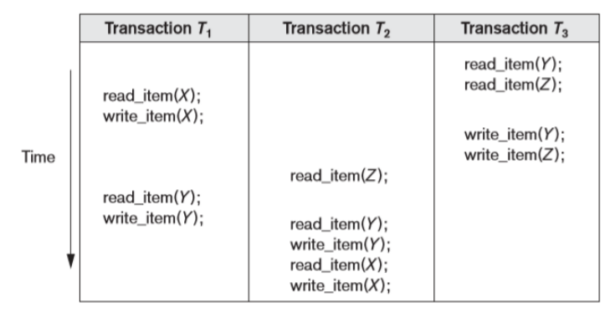
Example 2 - Precedence graph

Slide 21
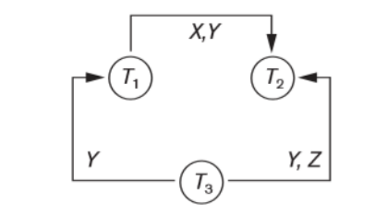
Example 2 - Precedence graph
No cycles
Equivalent serial schedule is T3 -> T1 ->T2

Slide 22
Practical Usage
Usage of precedence graph is not practical in real DB
Predicting the schedule is hard
Protocols used to enforce serializable schedules: 2PL and time stamping
Notes:
2 phase locking

Slide 23
View Serializability
Two schedules are view serializable, If the following rules are followed while creating the second schedule out of the first.
Transactions T1 and T2 are being serialized to create two different schedules. S1 and S2 which we want to be View Equivalent and both T1 and T2 wants to access the same data item.

Slide 24
View Serializability
If in S1, T1 reads the initial value of the data item, then in S2 also, T1 should read the initial value of that same data item.
If in S1, T1 writes a value in the data item which is read by T2, then in S2 also, T1 should write the value in the data item before T2 reads it.
If in S1, T1 performs the final write operation on that data item, then in S2 also, T1 should perform the final write operation on that data item.

Slide 25
Summary
Two schedules to become view serializable , the following 3 conditions should be satisfied.
Initial Reads
W-R Conflicts
Final Writes
A schedule S is said to be view serializable if it is view equivalent to a serial schedule.

Slide 26
Example 1- View Serializability
T1 | T2 | T3
 |  | R(x)
 | R(x)
 |  | W(x)
R(x)
W(x)
T2 | T3 | T1
R(x)
 | R(x)
 | W(x)
 |  | R(x)
 |  | W(x)
Notes:
Initial reads -> t2 and t3 both reads value from
DB
Final write ->T1
Conflicts -> t3 write is read by t1

Slide 27
Example 2- View Serializability
T1 | T2 | T3
 | R(b)
 | W(a)
R(a)
 |  | R(a)
W(b)
 | W(b)
 |  | W(b)
T1 | T2 | T3
 | R(b)
 | W(a)
 | W(b)
R(a)
W(b)
 |  | R(a)
 |  | W(b)
S1
S2

Slide 28
Question
S: R1(X), W2(X), W1(X), W3(X), C1, C2, C3
Is S View serializable?
Is S Conflict serializable?

Slide 29
Summary
Any schedule that is conflict-serializable is also view-serializable, but not necessarily the opposite.
Schedules
View Serializable
Conflict Serializable

Slide 30
Assignment 01
Will be uploaded into VLE : Date?
Lecture: Next week?

Slide 31
Thank you...

